Slide 1
3600 Broad Avenue Gulfport, MS 39501
(228) 864-7056
www.vitacareinc.com

Slide 2
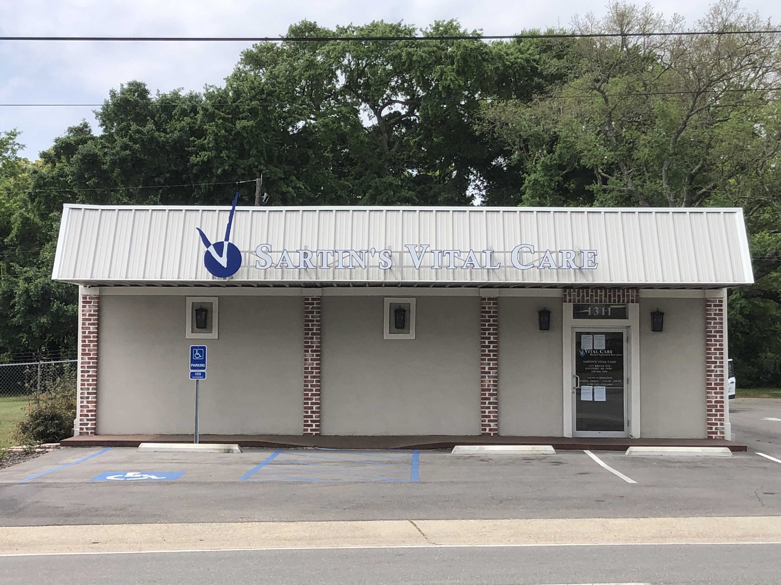
About Sartin’s Vital Care
Over 30 years service to the community
Knowledgeable and highly experienced staff
Service levels that outclass alternatives
Notable reputation within local medical community
Patent centric approach clinically and financially

Slide 3
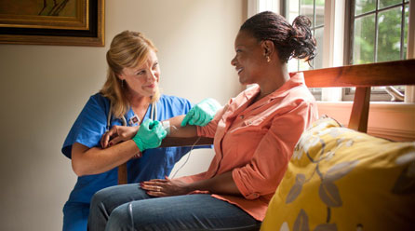
Empowering Patients To Get Infusions At Home
Antibiotics
TPN
IVIG
Remicade
Hydration
Enteral
...And many more!

Slide 4
Benefits Of Home Infusion
Greater convenience to patient, lifestyle advantages
Reduced risks of acquiring infection
Remarkably lower treatment costs
(up to 87% lower)
Better health outcomes

Slide 5
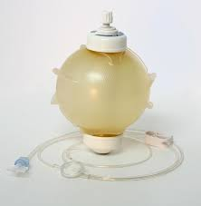
Ease Of Use – Elastomeric Pumps
Maintenance Free
Works independently of electronics
Single Use, Disposable
Cost effective

Slide 6
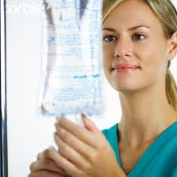
Common Disease States Treated At Home
Infections
Crohn’s Disease
Ulcerative Colitis
Immune Deficiencies
Rheumatoid Arthritis
Multiple Sclerosis (MS)
Lupus
Psoriatic Arthritis
…Many, Many More

Slide 7
Simple Referral Process
We do the work for you!
Schedule PICC line placement
Set up Home Health Nurse
Personal Delivery
Follow patient and make med changes

Slide 8
Verify Patient Benefits
Insurance coverage is determined before starting therapy
Eliminates surprise bills for patient
This Photo by Unknown Author is licensed under CC BY

Slide 9
Let Sartin’s Vital Care Help Your Patients Today
(228) 864-7056

Slide 10
Multiple Locations – Find Yours
Sartin’s is located in Gulfport MS and serves the MS Gulf Coast
Locations are available throughout the Southeast and across the US
Location finder available at:
www.vitalcareinc.com

Slide 11
Thank you!
Bob Rushing
Marketing
(228) 864-7056 - Office
(228) 257-9445 - Cell
brushing@vitalcareinc.com

